Slide 1
NLP section 5
Text Classification

Slide 2
Text Classification
Text Classification is the task of assigning a label or class to a given text
Why text classification?
1- Spam/Not Spam 2- Positive/Negative 3- Fake/Real 4- Bot/Human

Slide 3
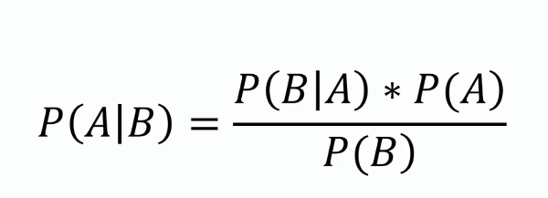
Multinomial Naive Bayes: Bayesian Theorem

Slide 4
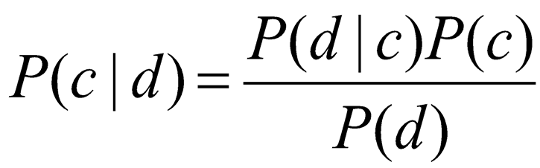
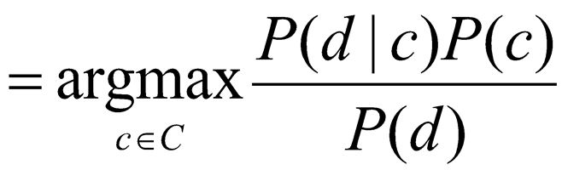
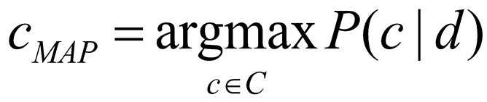
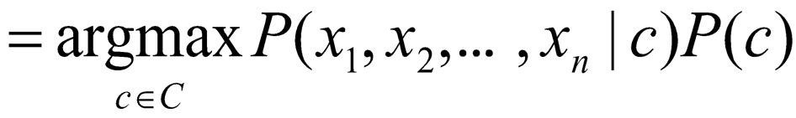
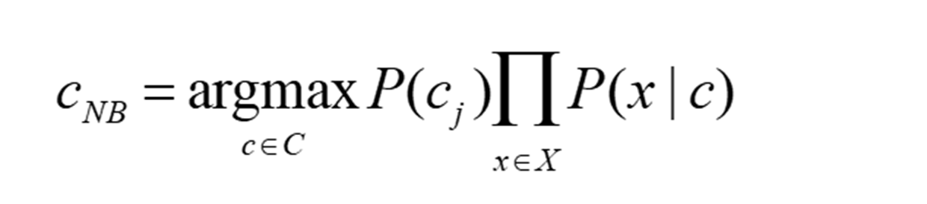
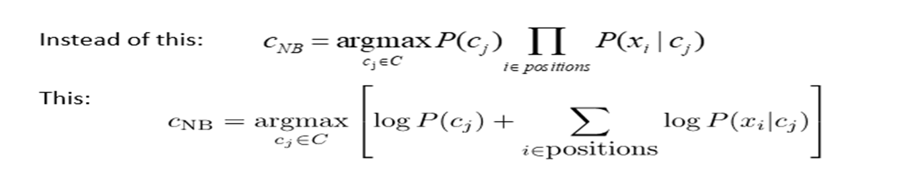
Multinomial Naive Bayes: Cont.

Slide 5
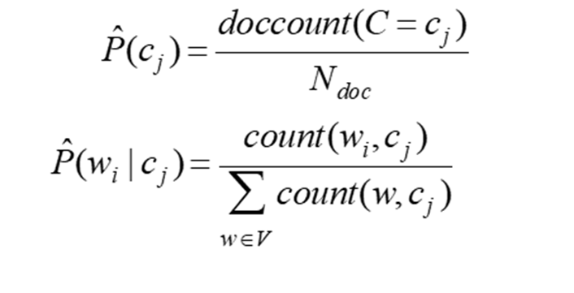
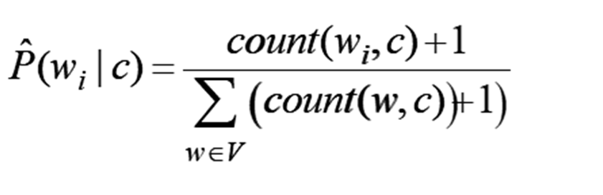

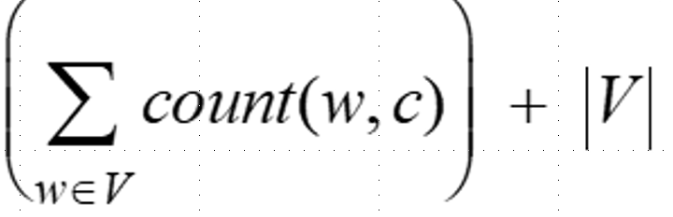
Multinomial Naive Bayes: Cont.
Laplace for Smoothing

Slide 6
Multinomial Naive Bayes: Example
Email | Class | Content
1 | Spam | "buy cheap toys now"
2 | Spam | "cheap replica watches buy"
3 | Spam | "buy toys cheap"
4 | Ham | "meeting schedule now"
5 | Ham | "project meeting tomorrow"
6 | Ham | "schedule project review"
Text to Classify:
Schedule meating review
Buy cheap watches now

Slide 7
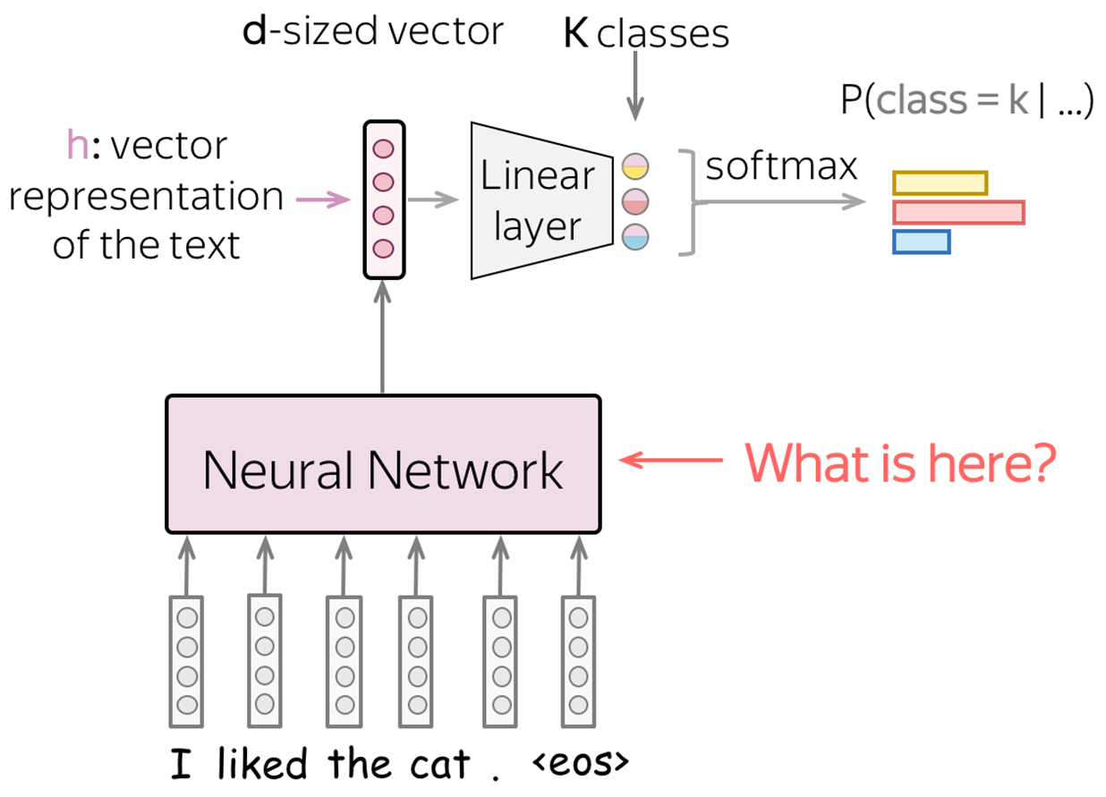
Neural Network

Slide 8
Code
Multinomial Naive Bayes
Neural Network
Neural Network with GloVe

